Slide 1

Customer Shopping Behavior Analysis
Analyzing 3,900 customer transactions to uncover insights into spending patterns, customer segments, and product preferences that drive strategic business decisions.

Slide 2

Dataset Overview
3,900
18
37
Total Purchases
Data Features
Missing Values
Transactions analyzed across all categories
Comprehensive customer and purchase attributes
Only in Review Rating column
Key features include customer demographics, purchase details, and shopping behavior metrics covering age, gender, location, subscription status, product categories, and shipping preferences.

Slide 3

Data Preparation & Engineering
01
Data Loading & Exploration
Imported dataset using pandas, checked structure with df.info() and summary statistics
02
Missing Data Handling
Imputed Review Rating nulls using median rating per product category
03
Feature Engineering
Created age_group bins and purchase_frequency_days columns for deeper analysis
04
Database Integration
Connected to PostgreSQL and loaded cleaned data for SQL analysis

Slide 4

Revenue Insights by Demographics
Gender Revenue Split
Age Group Performance
Male customers generated $157,890 in revenue compared to $75,191 from female customers, showing significant gender-based purchasing differences.
Young Adult: $62,143
Middle-aged: $59,197
Adult: $55,978
Senior: $55,763
Young adults lead revenue generation, presenting key targeting opportunities.

Slide 5
Product Performance Analysis
Top Rated: Gloves
Sandals
Boots
Average rating: 3.86
Average rating: 3.84
Average rating: 3.82
Hats (50% discount rate) and Sneakers (49.66%) are most discount-dependent, while top-rated products maintain strong customer satisfaction.

Slide 6
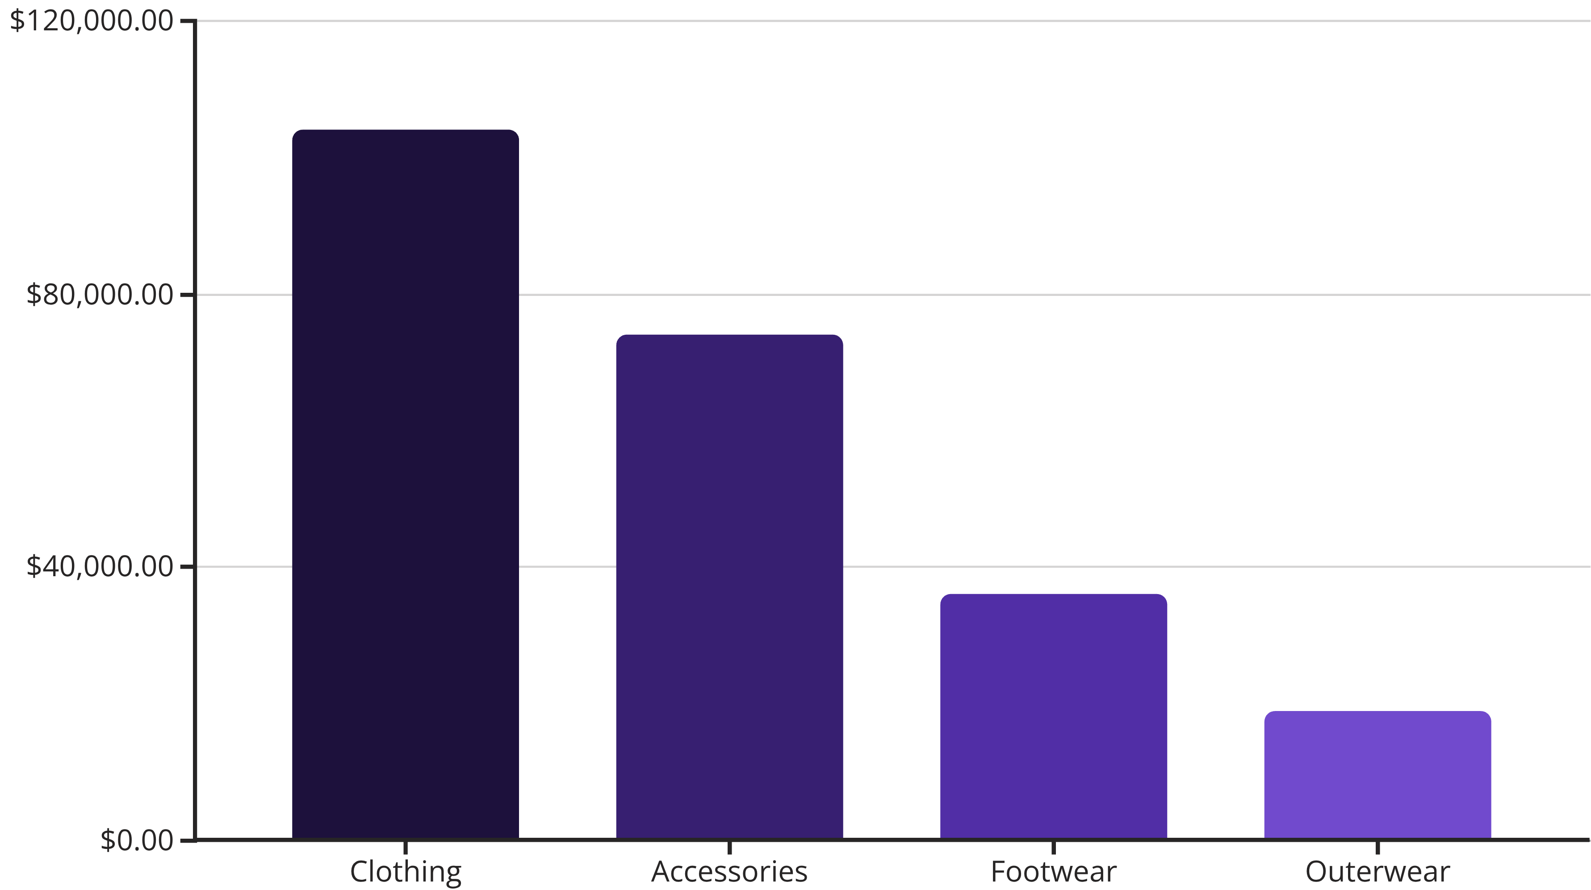
Category Revenue Distribution
Clothing dominates with $104K revenue, followed by Accessories at $74K. Top products include Blouses and Pants (171 orders each) in Clothing, and Jewelry (171 orders) in Accessories.

Slide 7



Customer Segmentation
New
1
83 customers
Returning
2
701 customers
Loyal
3
3,116 customers
The majority (80%) are loyal customers, indicating strong retention. However, 958 repeat buyers (>5 purchases) remain non-subscribers, representing a significant conversion opportunity.

Slide 8
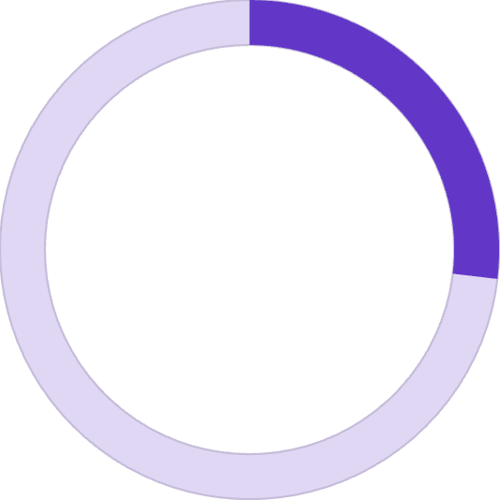


Subscription & Discount Behavior
High-Value Discount Users
839 customers used discounts but still spent above average purchase amount, demonstrating that strategic discounting doesn't necessarily reduce transaction value.
26.88%
Subscribers
1,053 customers
73.12%
Non-Subscribers
2,847 customers
Average spend is similar: subscribers at $59.49 vs. non-subscribers at $59.87.

Slide 9
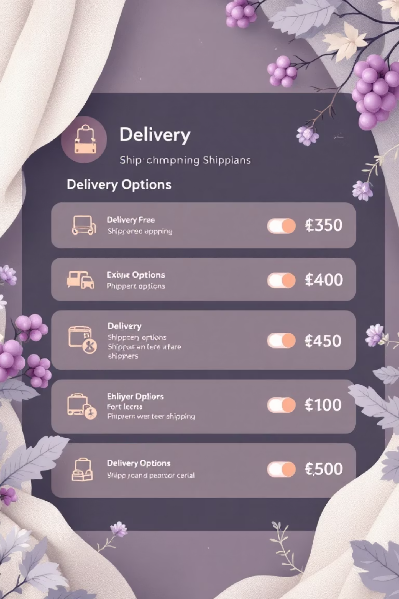

Shipping Preferences Impact
Express Shipping
Average purchase: $60.48
Higher-value orders prefer faster delivery
Standard Shipping
Average purchase: $58.46
Slight difference suggests shipping choice correlates with purchase value
Express shipping users show marginally higher spending, indicating potential for premium shipping upsells on larger orders.

Slide 10
Strategic Recommendations
Boost Subscriptions
Loyalty Programs
Optimize Discounts
Target 958 repeat buyers with exclusive benefits to convert non-subscribers
Reward returning customers to accelerate movement into loyal segment
Balance promotional strategy—839 high-spenders prove discounts work without sacrificing margins
Product Positioning
Targeted Marketing
Highlight top-rated items (Gloves, Sandals, Boots) and best-sellers in marketing campaigns
Focus on young adults and express-shipping users for maximum revenue impact

